Slide 1
Energy Consumption Analysis
Shanmugagouthaman Karuppiah
DTM - 10

Slide 2
AGENDA
Introduction
Problem Statement
Tools Used
Approaches
EDA Insights
Conclusion

Slide 3
INTRODUCTION
Welcome to the Energy Consumption Analysis project, a journey into the heart of Ontario's Broader Public Sector (BPS) organizations. Our mission is clear — to unravel the intricate tapestry of energy usage and greenhouse gas emissions. Through a lens of data-driven exploration, we aim to identify trends, evaluate the impact of conservation efforts, and pinpoint avenues for improvement. This project stands at the nexus of technology and sustainability, holding the promise of illuminating strategies to mitigate climate change within the BPS. Join us as we embark on this impactful exploration, where every data point has the potential to shape a more sustainable future.

Slide 4
PROBLEM STATEMENT
Project will analyze energy usage and greenhouse gas (GHG) emissions of Ontario's Broader Public Sector (BPS) organizations, leveraging a comprehensive database of reported data. We aim to identify trends, assess conservation effectiveness, and pinpoint areas for improvement, informing data-driven strategies to achieve climate change mitigation goals within the BPS.

Slide 5
TOOLS USED
In the pursuit of unraveling the complexities surrounding energy consumption, our toolkit is carefully curated to harness the power of data and analytics. The key tools employed in this project are:
1. Python: A versatile programming language, Python serves as the backbone for data manipulation, analysis, and model development, providing the flexibility needed for intricate tasks.
2. Jupyter Notebook: An interactive, open-source platform, Jupyter Notebook aids in seamless collaboration, allowing us to weave code, data, and insights into a cohesive narrative.
3. Excel: The familiar spreadsheet software plays a pivotal role in data preprocessing and structuring, providing a robust foundation for subsequent analytical processes.
4. PowerBI: As a dynamic data visualization tool, PowerBI transforms raw data into compelling visual narratives, facilitating a deeper understanding of patterns and trends.
These tools converge, enabling us to navigate the intricate landscape of energy data and extract meaningful insights, fostering a comprehensive and impactful analysis.

Slide 6
APPROACHES
1. Data Collection & Cleansing: Meticulously compiled and cleaned a comprehensive database of reported energy and greenhouse gas emissions data from Ontario's Broader Public Sector.
2. Exploratory Data Analysis (EDA): Employed advanced statistical techniques to reveal underlying patterns, trends, and anomalies in the energy consumption and emissions dataset.
3. Assessing Conservation Impact: Rigorously evaluated the effectiveness of existing conservation initiatives on energy usage and greenhouse gas emissions through insightful charts and visualizations.
4. Charting Improvement Opportunities: Utilized data-driven charts to pinpoint specific areas within the Broader Public Sector for targeted improvements, aligning with climate change mitigation goals.

Slide 7
EDA INSIGHTS
1. Energy Consumption Trends: Visualized and analysed the trends in energy consumption across different sectors within Ontario's Broader Public Sector, uncovering seasonal variations and year-over-year changes.
2. Greenhouse Gas Emissions Profile: Explored the distribution of greenhouse gas emissions, identifying major contributors and assessing the carbon footprint of various organizations.
3. Operational Efficiency: Delved into operational efficiency with a dedicated Power BI tab showcasing the top 10 cities and organizations contributing to energy consumption, providing a detailed view of the operational landscape.

Slide 8
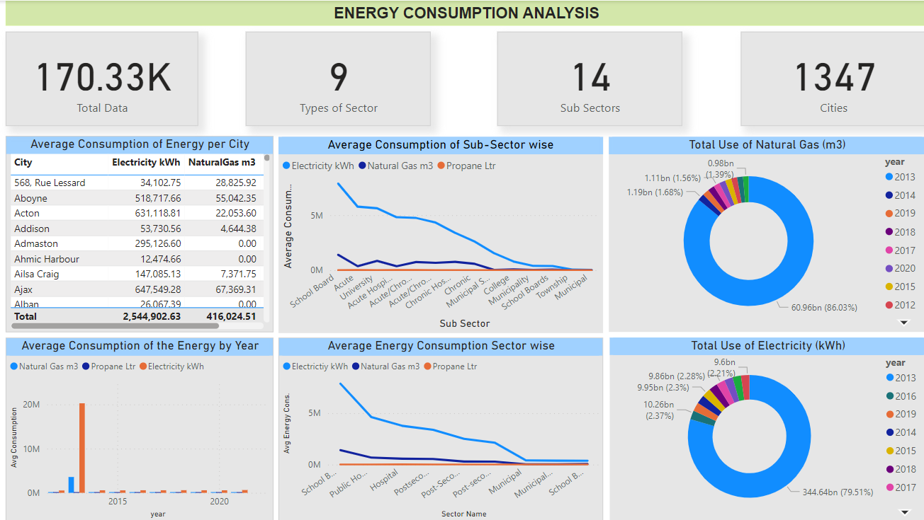
SOME CHARTS FROM POWERBI

Slide 9
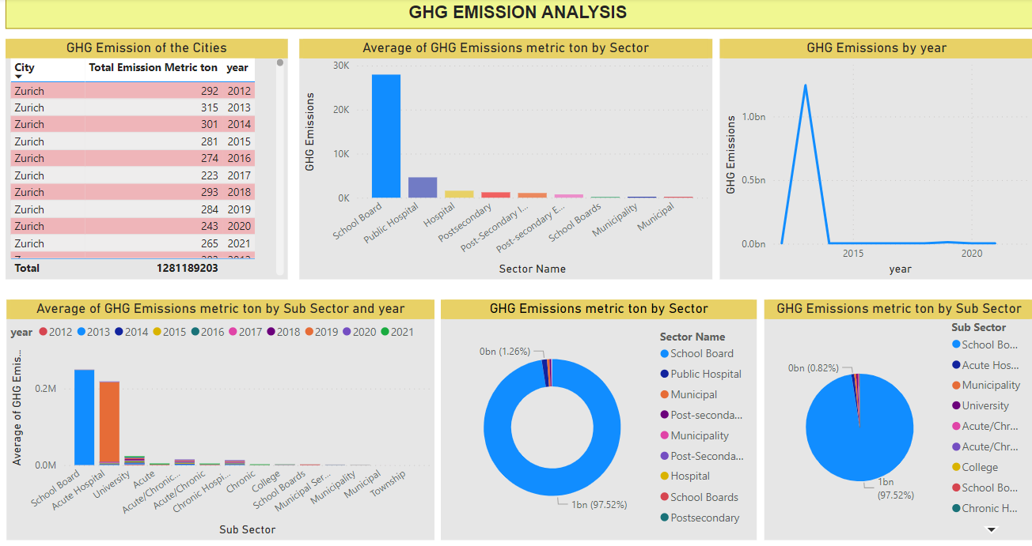

Slide 10
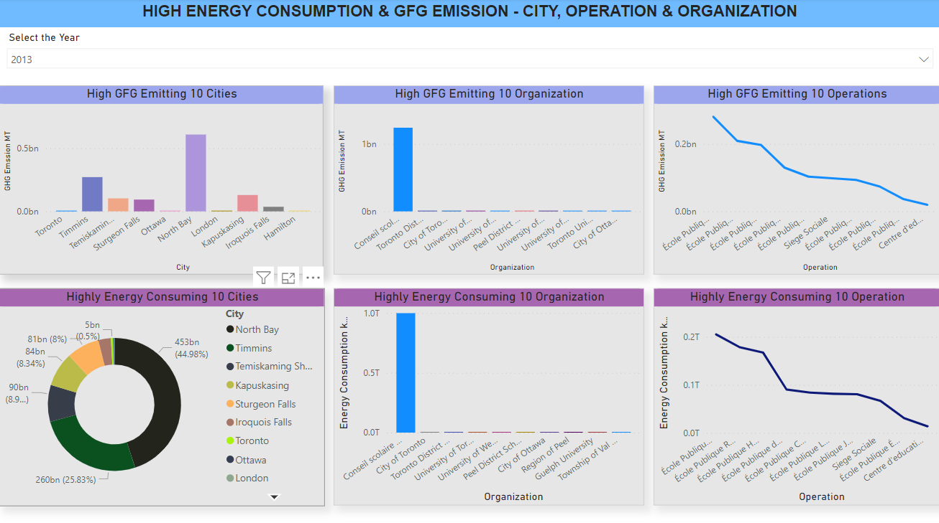

Slide 11
CONCLUSION
At 7,876,918.46, School Board had the highest Electricity kWh and was 25,543.24% higher than Municipal, which had the lowest Electricity kWh at 30,717.33.﻿﻿ ﻿﻿ ﻿﻿
Electricity kWh and total Natural Gas m3 are positively correlated with each other.﻿﻿
﻿﻿ ﻿﻿
Across all 14 Sub Sector, Electricity kWh ranged from 30,717.33 to 7,876,918.46, Natural Gas m3 ranged from 2,226.73 to 1,404,274.96, and Propane Liter ranged from 0 to 6,325.63.﻿﻿ ﻿﻿
﻿﻿2013 accounted for 86.03% of Sum of Natural Gas Qty m3.﻿﻿ ﻿﻿
﻿
﻿At 1245569556, 2013 had the highest Sum of GHG Emissions metric ton and was 49,191.17% higher than 2020, which had the lowest Sum of GHG Emissions metric ton at 2526963.﻿﻿ ﻿﻿
﻿
﻿﻿2013 accounted for 97.22% of Sum of GHG Emissions metric ton.﻿﻿ ﻿﻿ ﻿﻿
Across all 10 year, Sum of GHG Emissions metric ton ranged from 2526963 to 1245569556.﻿﻿
﻿﻿
﻿﻿School Board in year 2013 made up 46.33% of Average of GHG Emissions metric ton.

Slide 12
THANK YOU

